Slide 1

Machine Learning for Public Policy Lab (aka Data Analysis Class)
Rayid Ghani and Kit Rodolfa

Slide 2
What we want you to learn from this class
How to solve real-world (public policy) problems using Machine Learning
Learn how to use ML methods (that you have covered in earlier classes)
Understand the entire Machine Learning process
Build reusable ML pipelines

Slide 3
Who is in this class?
MLD Students (PhD and Masters - required class)
Heinz Students
Others?
Notes:
After this, whiteboard exercise discussing the pipeline based on students’ prior experiences ~20-30 min

Slide 5
Pre-requisites
Python
Machine Learning

Slide 6
How is this course different than a typical ML class?
We’ll assume everyone knows most of the methods and focus on everything else

Slide 7
Skills needed to solve real-world problems with ML
Computer Science &
Programming
Statistics
Classes
Social Sciences

Slide 8
Skills needed to solve real-world problems with ML
Computer Science &
Programming
Problem
Formulation
Statistics
Communication
REAL
WORLD
Social Sciences
Ethics &
Legal Issues
Experimental
Design
Notes:
For ML students, previous iterations of this class probably involved some readings and assignments in each of these areas. This semester, we’re taking a more hands-on project-focused approach.

Slide 9
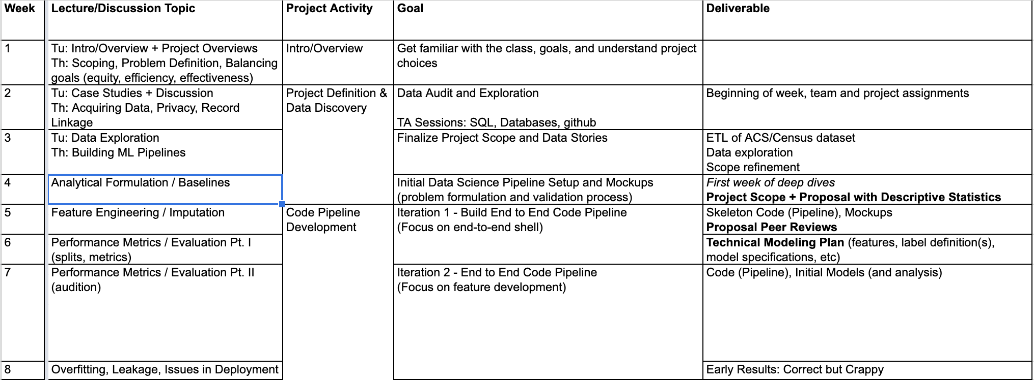
Class Schedule

Slide 10
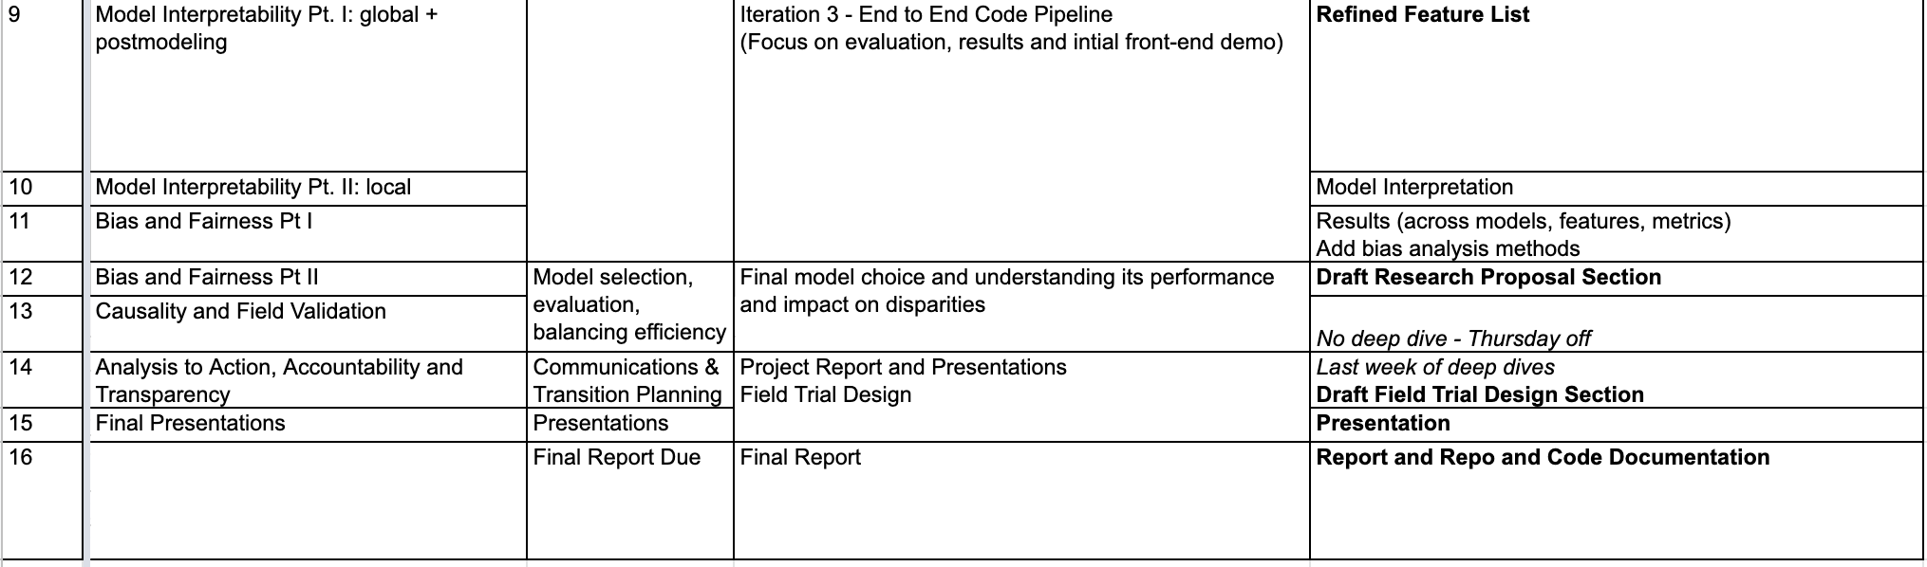
Class Schedule

Slide 11
Different components of the class
Group Projects – solving end to end (public policy) problems
Lectures
Readings
Student Presentations
Discussions
Assignments (project-related)

Slide 12
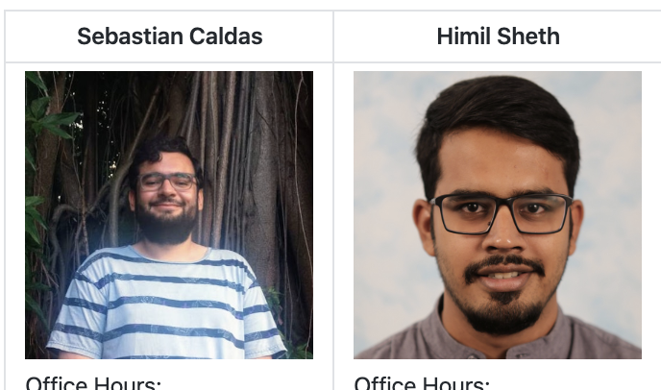
Logistics
TAs
Technical review sessions
Office hours
Weekly Reviews (due before class every Tuesday)
Project
Attendance (is not optional)
Github page (for content)
Canvas (for content + submissions) and Piazza (for questions and discussion)

Slide 13
Weekly Structure
Tuesdays will typically be lectures and 2-3 minute updates from each team
Thursday will typically be ~20 minute deep dives from 2-3 teams/week and finishing up the weekly topic from tuesday
Additional tech sessions for specific topics will take place 1-2 times / week

Slide 14
Project Teams
Make sure to fill out the survey by 6pm today
We need this get you set up on the infrastructure and form teams
If you didn’t include a public SSH key, email it to us ASAP!
We’ll make 4-person teams at the end of this week to balance your preferences, experience, and background
We might need to adjust based on people dropping the class
Notes:
If you think you’re likely to drop, please let us know sooner rather than later so we can balance teams

Slide 15
Projects
Identifying students who are at risk of not graduating high school on time and need extra support
Reducing jail recidivism rate by identifying individuals at risk of returning to jail and need mental health support
Improving police community relations by identifying police officers at risk of adverse incidents with the public
Reducing hazardous waste violations by prioritizing environmental inspections
Early Warning System for Identifying individuals at risk of prison recidivism
Improving charitable donation asks by identifying projects at risk of not being funded
Increasing civic engagement by identifying voters not likely to vote in elections

Slide 16
The data you’re working with is confidential and needs to be kept secure
Do not download or copy any data from the server on your local machine *
Keep your credentials secure and do not commit them to github
Tell us immediately if you suspect that any data you had access to may be compromised

Slide 17
Tech Setup
Make sure you have the following things set up:
ssh (to connect to the server) mlpolicylab.dssg.io
Dbeaver and psql (to connect to the database) mlpolicylab.db.dssg.io
Github (to collaborate, share code with your team, and submit code) github.com/dssg/mlforpublicpolicylab
Get familiar with:
Postgresql (to analyze and query data)
*nix command line
Git
Remote server workflow
We’ll have tech sessions this week to help
Thursday 12-1 and 4:30-5
Friday 10-11
We’ll have tech sessions next week to help
Schedule TBD based on student poll

Slide 18
Prep for next class
Tech setup
Readings
Project Scoping guide
Example case study
Notes:
We’ll be creating accounts on Wednesday and send around instructions about connecting to the course infrastructure once they’re ready for you to log on

